Slide 1
EndTest Document Generator
By: Austin Ibele

Slide 2
Overview
Program Structure
Changing Preset Specifications
Adding on later

Slide 3
Program Structure
The program is written as one continuous function. The code executes from the top line to the bottom.

Slide 4
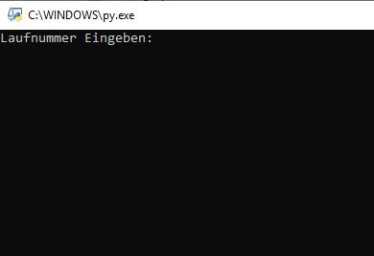
Starting Program
Open the Python file at Alle/ERSTools/Endtest Document Generator/
Endtest Docgenerator VX.X.py
Enter Lauf Number and hit enter
The lauf number is searched for in the spreadsheet: R:\Endtest\30_Seriennummern\Seriernnummern.xlsm
2. Order components are parsed from the spreadsheet
3. Algorithms determine shipping boxes, weight, names, etc

Slide 5
Making changes
Many things can be changed without editing the source code
Adding new products, changing shipping crate types of weights, can be changed from spread sheets

Slide 6
Making Changes
X:\ERSTools\Endtest Document Generator\notchiller.xlsx
Contains components that are in the chiller column of the seriernnummern XLS but are not actually chillers
‘st’ column contains the ‘string’ that identifies the component
‘type’ column tells what type the component actually is, since it is not a chiller
X:\ERSTools\Endtest Document Generator\ref_chillers.xlsx
Contains information of crate number/crate weight, depending on chiller type
‘index’ column contains the ‘string’ of digits that identifies the chiller
‘stuck’ tells what the full name of the chiller actually is
‘verpackung’ is the crate #
‘gewicht’ is the weight in kg of the chiller inside the crate

Slide 7
Making changes (continued)
X:\ERSTools\Endtest Document Generator\ref_chucks.xlsx
Contains information of crate number/crate weight, depending on chuck type
‘index’ column contains the ‘string’ of digits (+’mm’) that identifies the chuck
‘stuck’ tells what the chuck is (it is the same as the index in this case)
‘verpackung’ is the crate # if the chuck is not shipped with a controller
‘system verpackung’ is the crate # if the chuck is shipped with a controller
‘gewicht’ is the weight in kg of the chuck alone inside the crate
‘system gewicht’ is the weight in kg of the chuck and controller inside the crate

Slide 8
Making changes (continued)
X:\ERSTools\Endtest Document Generator\ref_controllers.xlsx
Contains information of crate number/crate weight, depending on controller
Pertains to controllers that are NOT shipped with a chuck
‘index’ column contains the ‘string’ of digits that identifies the controller
‘stuck’ tells what the chuck is (it is the same as the index in this case)
‘verpackung’ is the crate that the controller would be shipped in alone
‘gewicht’ is the weight in kg of the controller inside the crate
If verpackung or gewicht is empty, it is because the component is not actually a controller. It is a small VG or RSI that does not need a separate box.

Slide 9
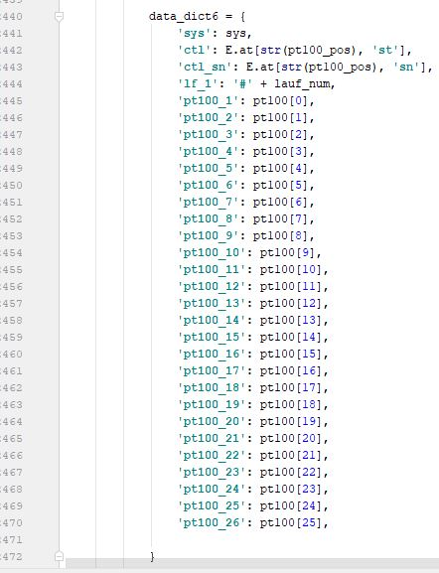
Making changes to documents
Fillable PDFs are created from an Open Office format document
You cannot change the fields in Word. You NEED Open Office
https://smallbusiness.chron.com/create-openoffice-fillable-forms-74857.html
Green text in data dict = names of fields in Open Office
Note: Fields in open office do not have a border in the completed documents.
I suggest using a border while working on the document formatting, and
then removing the border later

Slide 10
Making changes to source code
Change the write directory path so that you can troubleshoot without overwriting real documents
Email me if you can’t figure it out Austin.ibele@gmail.com

